Slide 1
Development of master curricula for natural disasters risk management in Western Balkan countries
Accreditation of master curricula
Milan Gocić, University of Niš
London, 21st March 2019
Project number: 573806-EPP-1-2016-1-RS-EPPKA2-CBHE-JP
"This project has been funded with support from the European Commission. This publication reflects the views only of the author, and the Commission cannot be held responsible for any use which may be made of the information contained therein"

Slide 2
Development of master curricula for natural disasters risk management in Western Balkan countries
UNI Faculty of Civil Engineering and Architecture (GAF)–MAS–Engineering management for natural disaster risk
No. | Code | Subjects | Hours L+E+CS | ECTS
FIRST SEMESTER
1. | M | Integrated natural disaster risk management | 2+2+0 | 5
2. | M | Building resilience to natural disasters | 2+2+0 | 5
3. | M | Protection and rescue system | 2+2+0 | 5
4. | E | Elective subject 1 | 2+2+0 | 5
5. | E | Elective subject 2 | 2+2+0 | 5
6. | E | Elective subject 3 | 2+2+0 | 5
 |  | Seismic risk management
 |  | Risk management in geotechnical engineering
 |  | Drought and flood risk management
 |  | Sustainable development of settlements and natural disaster
 |  | Application of geographic information systems (GIS) in risk management
SECOND SEMESTER
7. |  | Research work | 0+0+20 | 16
8. |  | Practice |  | 2
9. |  | Master thesis |  | 12
Notes:
For example in the study program Engineering management for natural disaster risk there are 3 mandatory subjects and 3 elective subjects.

Slide 3
Development of master curricula for natural disasters risk management in Western Balkan countries
UNI Faculty of Occupational Safety (FZnR) – MAS – Catastrophic events management
No. | Code | Subjects | Hours L+E+CS | ECTS
FIRST SEMESTER
1. | M | Emergency Management Systems | 2+2+0 | 5
2. | M | Fire dynamics | 2+2+0 | 5
3. | M | The theory of human error | 2+2+0 | 5
4. | M | Risk and recovery of the accident | 2+2+0 | 5
5. | E | Elective subject 1 | 2+2+0 | 5
6. | E | Elective subject 2 | 2+2+0 | 5
 |  | Project Management
 |  | Decision making theory
 |  | Psychology of groups
 |  | Public relations
 |  | English language
SECOND SEMESTER
7. | M | Civil protection | 2+2+0 | 5
8. | M | Tactics of intervention and rescue | 2+2+0 | 4
9. | E | Elective subject 3 | 2+2+0 | 4
10. | E | Elective subject 4 | 2+2+0 | 4
 |  | System engineering
 |  | Human resource management
 |  | Information communication networks
 |  | Fire expertise
 |  | Health protection
11. |  | Practice |  | 3
12. |  | Master thesis |  | 10
Notes:
Here is presented study program Catastrophic events management offered by Faculty of occupational safety. There are 6 M and 4 E subjects.
Acreditated study program is somewhat changed.

Slide 4
Development of master curricula for natural disasters risk management in Western Balkan countries
Academy of criminalistics and police studies (KPA)–MAS–Natural disasters security risk management
No. | Code | Subjects | Hours L+E+CS | ECTS
FIRST SEMESTER
1. | M | Methodology of research of security phenomena | 2+2+0 | 6
2. | M | Risk management | 3+1+0 | 6
3. | M | Natural disasters | 3+1+0 | 6
4. | E | Elective subject 1 | 2+2+0 | 6
5. | E | Elective subject 2 | 2+2+0 | 6
 |  | Protection and rescue system in natural disasters
 |  | Modeling and simulation of security risks from natural disasters
 |  | Information and communication support to the natural disasters security risks management
 |  | Right to emergency situations caused by natural disasters
SECOND SEMESTER
7. |  | Research work | 0+0+20 | 15
8. |  | Master thesis |  | 15
Notes:
Here is SP Natural disasters security risk management proposed by

Slide 5
Development of master curricula for natural disasters risk management in Western Balkan countries
University of Pristina settled in Kosovska Mitrovica (UPKM)–MAS - Natural disaster risk management
No. | Code | Subjects | Hours L+E+CS | ECTS
FIRST SEMESTER
1. | M | Natural disasters | 2+2+0 | 6
2. | M | Natural disasters risk assessment | 2+2+0 | 5
3. | M | Transportation systems in natural disasters | 3+3+0 | 5
4. | M | Institutional framework in NDRM | 2+1+0 | 4
5. | E | Elective subject 1 | 2+2+0 | 5
6. | E | Elective subject 2 | 3+3+0 | 5
 |  | Monitoring in prevention, recording and estimation of natural disasters
 |  | Information technologies in natural disaster risk management
 |  | Natural disasters with participation of chemical agents
 |  | Urban design for disaster mitigation
SECOND SEMESTER
7. | M | Natural disasters risk management | 2+2+0 | 5
8. | M | Power supply in post disaster period | 2+2+0 | 5
9. | E | Elective subject 3 | 2+2+0 | 5
 |  | Post disaster measures in waste, water and sewer management
 |  | Water resources management in natural disaster situations
10. |  | Internship |  | 3
11. |  | Master thesis |  | 12

Slide 6
Development of master curricula for natural disasters risk management in Western Balkan countries
University of Sarajevo (UNSA - CIS) – MAS - Natural disaster risk management
No. | Code | Subjects | Hours L+E+CS | ECTS
FIRST SEMESTER
1. | M | Natural disasters and catastrophes | 2+2+0 | 5
2. | M | Risk management from natural disasters | 2+2+0 | 5
3. | M | Spatial planning in the function of reducing the risk of disasters | 2+2+0 | 5
4. | E | Elective subject 1 | 2+2+0 | 5
5. | E | Elective subject 2 | 2+2+0 | 5
6. | E | Elective subject 3 | 2+2+0 | 5
 |  | Protection and rescue system in natural disasters
 |  | Water - environmental problems in case of natural disasters
 |  | Water protection and sustainable development
 |  | In-situ testing and monitoring
 |  | Evaluation and reinforcement of structures
 |  | Earthquakes and numerical modeling of structures
 |  | Rehabilitation of objects of cultural and historical heritage
 |  | Durability of material as a preventive measure
 |  | Cartography
 |  | Topographic / cartographic models
 |  | Spatial databases and IPPs
 |  | Remote surveys
 |  | Information and communication technologies for risk management from natural disasters
SECOND SEMESTER
7. |  | Research in the field of master work | 0+20+0 | 15
8. |  | Master thesis |  | 15
Notes:
According the informationt his studiyprogram will start this year.

Slide 7
Development of master curricula for natural disasters risk management in Western Balkan countries
University of Banja Luka (UBL) – MAS - Natural Disaster Risk Management
No. | Code | Subjects |  | Hours L+E+CS | ECTS
FIRST SEMESTER
1. | M | Methodology of scientific research |  | 3+1+0 | 6
2. | M | Natural disasters risk management |  | 3+1+0 | 5
3. | M | Natural disasters and catastrophes |  | 3+1+0 | 6
4. | M | Protection and rescue system in natural disasters |  | 3+1+0 | 5
5. | E | Elective subject 1 |  | 2+1+0 | 4
6. | E | Elective subject 2 |  | 2+1+0 | 4
 |  | Protection of critical infrastructure in natural disasters
 |  | Prevention and suppression of crime in conditions of natural disasters
 |  | Law regarding emergency situations caused by natural disasters - Legal framework for risk management
 |  | Information and communication technologies in support of risk management from natural disasters
 |  | Crisis management and communication in natural disasters
 |  | Environmental safety and natural disaster
 |  | Competence and role of the police in natural disasters
SECOND SEMESTER
7. |  |  | Research work | 300 | 20
8. |  |  | Master thesis |  | 10
Notes:
Student admission will start at the University Banja Luka

Slide 8
Development of master curricula for natural disasters risk management in Western Balkan countries
Technical College of Applied Sciences Urosevac-Leposavic (TCASU)–Disaster Risk Management and Fire Safety
No. | Code | Subjects | Hours L+E+CS | ECTS
FIRST SEMESTER
1. | M | English language – higher course | 2+2+0 | 6
2. | M | Research methods and scientific communications | 2+2+0 | 6
3. | M | Natural disasters | 2+2+0 | 6
4. | M | Fire dynamics and expertise | 2+2+0 | 6
5. | E | Elective subject 1 | 2+2+0 | 6
 |  | Risks management legal frameworks
 |  | Information and communication technologies in risk management
SECOND SEMESTER
6. | M | Fire extinguishers and equipment | 3+3+0 | 7
7. | M | Protection and rescue | 3+3+0 | 7
8. | E | Elective subject 2 | 3+3+0 | 6
 |  | Management and development of human resources
 |  | Sustainable development and environmental protection
9. |  | Professional practice |  | 2
10. |  | Specialist Thesis |  | 8

Slide 9
Development of master curricula for natural disasters risk management in Western Balkan countries
University of Defense in Belgrade – Military academy (UNID)-MAS–Natural Disaster Risk Management
No. | Code | Subjects | Hours L+E+CS | ECTS
FIRST SEMESTER
1. | M | Natural disasters | 2+3+0 | 6
2. | M | Natural disasters risk management | 3+2+0 | 6
3. | M | Protection and rescue system in natural disaster situations | 2+3+2 | 8
4. | E | Elective subject 1 | 2+2+0 | 5
5. | E | Elective subject 2 | 2+2+0 | 5
 |  | Operational research
 |  | Models to support to decision-making process in natural disasters
 |  | Organization of state administration in emergency situations
 |  | Application of GIS in risk assessment in Natural Disaster Situations
SECOND SEMESTER
6. | M | Methodology of scientific research in the field of security and defense | 2+2+0 | 6
7. | E | Elective subject 3 | 2+3+0 | 6
 |  | Operations for support to civilian authorities in Natural Disaster Situations
 |  | Security Management in Natural Disaster Situations
 |  | Assanation field and radiological, chemical and biological technologies
8. |  | Study research work on the basis of master work | 0+0+8 | 8
9. |  | Master thesis |  | 10

Slide 10
Development of master curricula for natural disasters risk management in Western Balkan countries
Institution | Study program | Title
UNI-GAF | ENGINEERING MANAGEMENT FOR NATURAL DISASTERS RISK | Master engineer manager
UNI-FZnR | CATASTROPHIC EVENTS MANAGEMENT | Master engineer for protection from catastrophic events and fire
KPU | NATURAL DISASTERS SECURITY RISK MANAGEMENT | Master security manager
UPKM | NATURAL DISASTERS RISK MANAGEMENT | Master engineer for protection from catastrophic events and fire
UNSA-CIS | NATURAL DISASTERS RISK MANAGEMENT | Master engineer manager
UNBL | NATURAL DISASTERS RISK MANAGEMENT | Master security manager
TCASU | DISASTER RISK MANAGEMENT AND FIRE SAFETY | Engineer protection from catastrophic events and fire
UNID | NATURAL DISASTERS RISK MANAGEMENT | Master manager
Notes:
Here is presented overview of study programs proposed by institutions involved in this project.

Slide 11
Development of master curricula for natural disasters risk management in Western Balkan countries
No. | Institution | Subjects (M+E) | New subjects (M+E)
1 | UNI-GAF | 3+5 = 8 | 3+5 = 8
2 | UNI-FZnR | 6+10 = 16 | -
3 | KPA | 3+4 = 7 | 3+4 = 7
4 | UPKM | 6+6 = 12 | 6+6 = 12
5 | UNSA-CIS | 3+13 = 16 | 3+12 = 15
6 | UNIBL | 4+7 = 11 | 3+7 = 10
7 | VTSU | 6+4 = 10 | 3+4 = 7
8 | UNID | 4+7 = 11 | 4+7 = 11
 | SUM | 35+56 = 91 | 25+45 = 70
8 study programs
91 subjects
70 new subjects

Slide 12
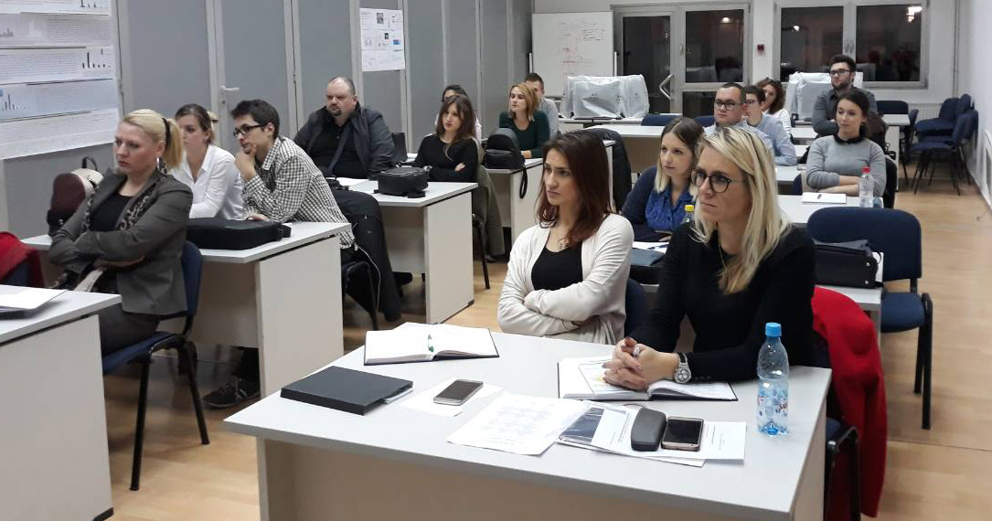
University of Sarajevo
Development of master curricula for natural disasters risk management in Western Balkan countries
Decision: 11-05-38-21312-1/18, 24 May 2018

Slide 13
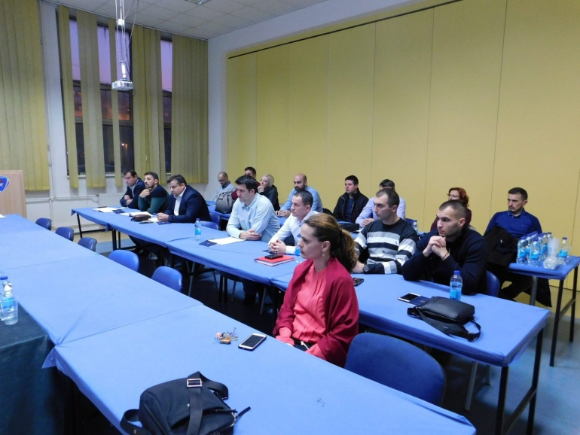
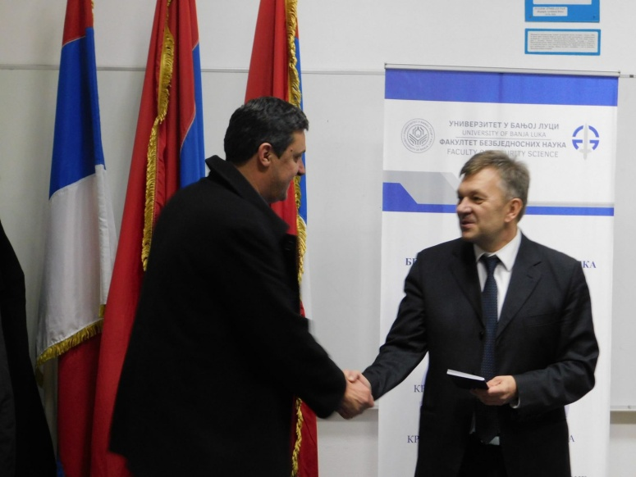
University of Banja Luka
Development of master curricula for natural disasters risk management in Western Balkan countries
Decision: 07.050/612-145-55/17, 23 August 2018

Slide 14
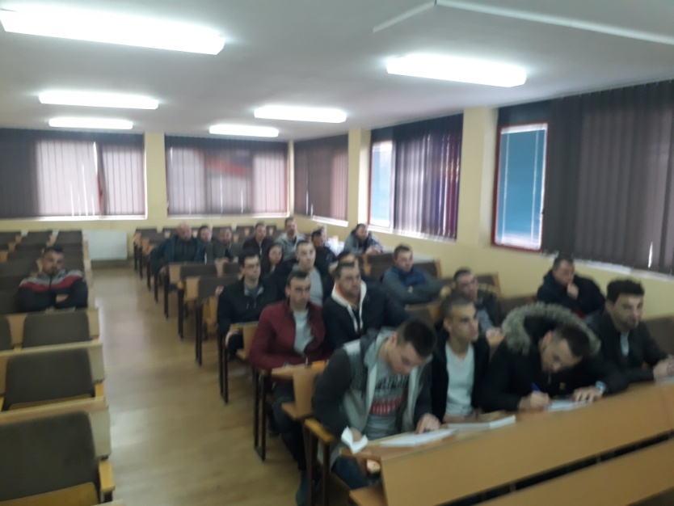
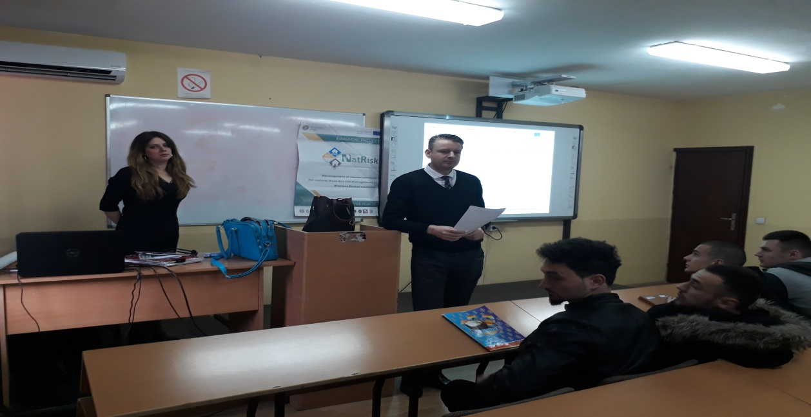
TCASU
Development of master curricula for natural disasters risk management in Western Balkan countries
Decision: March 2019

Slide 15
Other HEIs
Development of master curricula for natural disasters risk management in Western Balkan countries
?

